Slide 1


​Patient Health record assistant to enable easy
retrieval of data from
complex JSON files​.
Team Name : CTRL FREAKS
Team No: 4​
RMKEC

Slide 2
Team Members​ | Team Members ​ mail Id​ | Team Faculty ​ Mentor​ | Faculty Mentor mail Id​ | Cognizant ​ Mentor name​ | Cognizant Mentor mail Id​
Prathiksha K​ | prat21206.ad@rmkec.ac.in​ | ​ ​ ​ ​ ​ Dr. Srijayanthi S​ ​ ​ ​ Ms. Ani Minesha​ | ​ ​ ​ ​ ​ ssj.ad@rmkec.ac.in​ ram.ad@rmkec.ac.in | ​ ​ ​ ​ ​ Mr. Sadaiyappan Theivarayan​ ​ ​ Ms. Sathya Prabha ​ Nanjundamoorthy​ | ​ ​ ​ ​ ​ sadaiyappan.theivarayan@cognizant.com​ ​ ​ sathyaprabha.nanjundamoorthy@cognizant.com​
Meeniga Akhila​ | meen21126.ad@rmkec.ac.in​
Nivedha P​ | nive21204.ad@rmkec.ac.in​
Tamizh Malar S G​ | tami21218.ad@rmkec.ac.in​
Varsha S​ | vars21223.ad@rmkec.ac.in​
Jaya Bharathi J​ | jayale221805.ad@rmkec.ac.in​
Team details​
•Team Name – Ctrl Freaks​
•Team No – 4​
• RMKEC

Slide 3



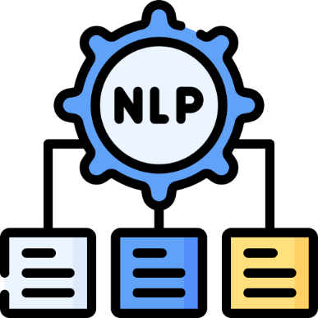


Challenge Specification
Complexity of JSON Data​
Simplifying access to highly complex and nested medical records stored in JSON format.
Integration​
Ensuring seamless integration and accurate retrieval from our JSON format data is challenging.
.
User Experience
Designing an intuitive interface for healthcare providers, insurers, and patients.
NLP Accuracy​
Translating natural language queries into precise database queries accurately.

Slide 4







Action Plan
1. User Query Input:
Users provide their questions in natural language via a user-friendly interface.
4. Data Retrieval:
The query engine fetches the required patient details from the MongoDB database based on the query.
2. Natural Language to MongoDB Query Conversion:
A fine-tuned BART model translates the natural language questions into precise MongoDB queries for the computer to understand.
5. Natural Language Response Generation:
A Pegasus model then processes the retrieved data to generate a natural language response.
3. Query Processing:
The query engine processes the MongoDB query, which interacts with the MongoDB database where all the patient records are stored.
6. User-Friendly Output:
Responses are delivered through an easy-to-use interface, Enhanced with a voice assistant and PDF download for patient data.

Slide 5
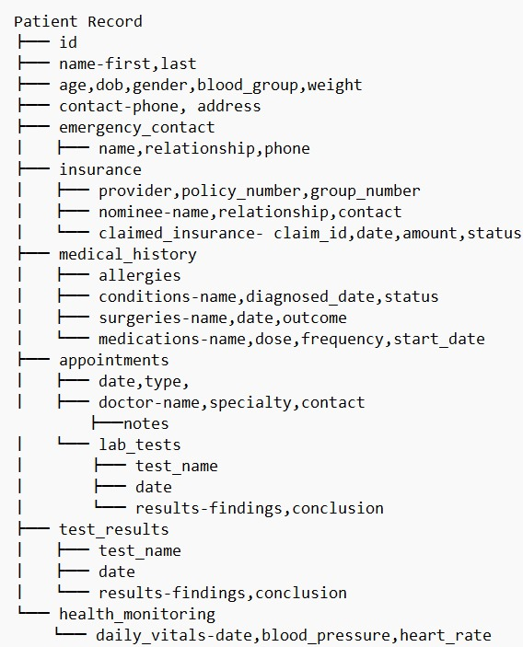




DataSet, Technology stack
Dataset: Complex JSON medical records generated from ChatGPT.
Tech-Stack
.
Scripting Language: Python
Models: BART, Pegasus
Framework: Flask
Database: MongoDB
Frontend: HTML, CSS, JS
Dataset Size: 80,000 data
Dataset Attributes

Slide 6



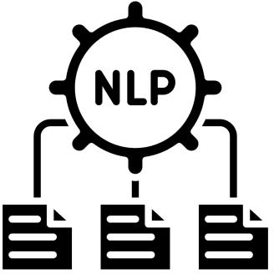

Why?
MongoDB - Well-suited because of its adaptable, document-oriented storage that integrates seamlessly with JSON data
BART (Bi-directional Autoregressive Transformer) - Transformer-based architecture excels at generating accurate, context-aware queries.
Pegasus (Pre-training with Extracted Gap-sentences for Abstractive Summarization) - Its strong summarization capabilities, generate clear and contextually relevant text even from semi-structured data.
Flask – Enables quick and customizable web development with minimal overhead.

Slide 7
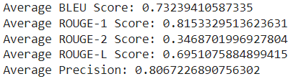
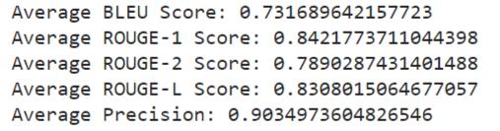
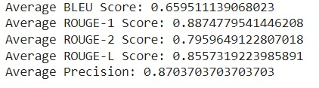
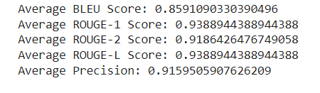
Models
BART excels at mapping NL input to precise MongoDB queries, making it more effective for the initial phase compared to CodeT5.
Code T5
Bart
PEGASUS delivers precise, informative summaries and fluent translations, making it a robust choice for summarization and translation tasks than FlanT5.
Flan T5
Pegasus

Slide 8
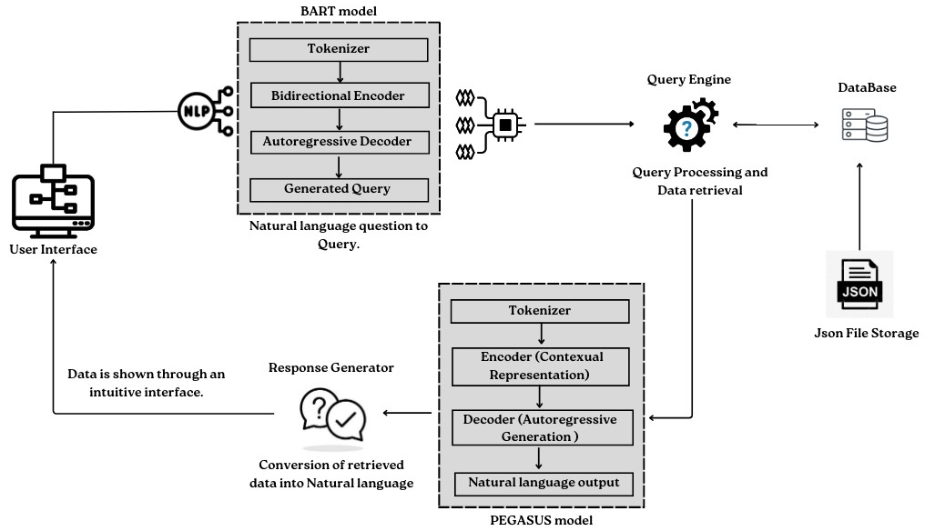
System Architecture

Slide 9
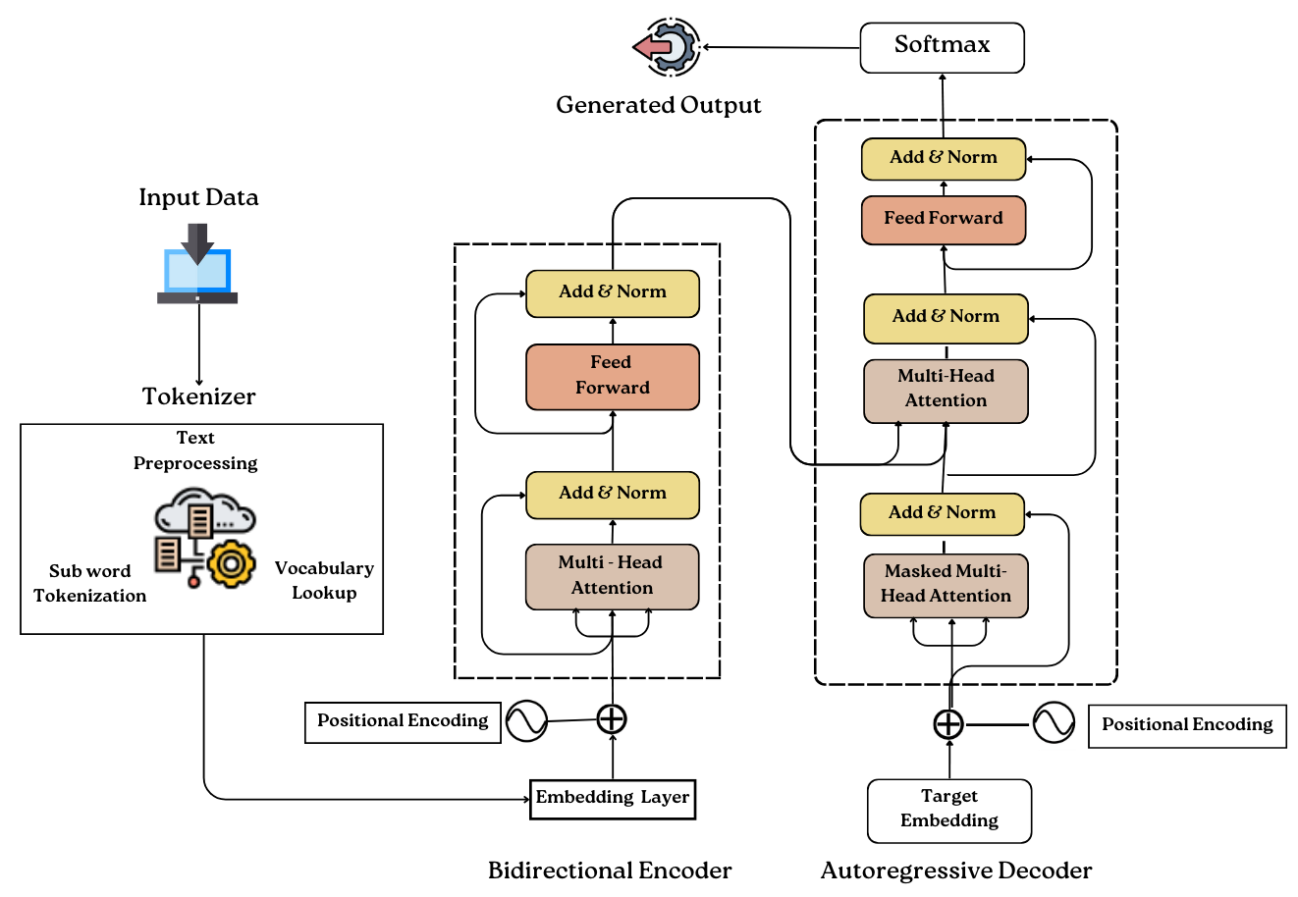




Model’s Representation
BART
NLQ
Query
PEGASUS
Retrieved
JSON data
Natural Language Query

Slide 10
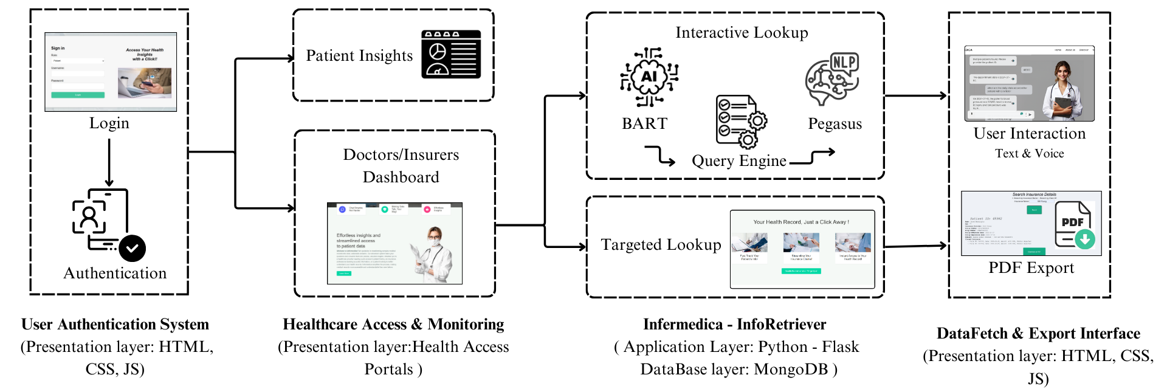
UI Flow Diagram

Slide 11
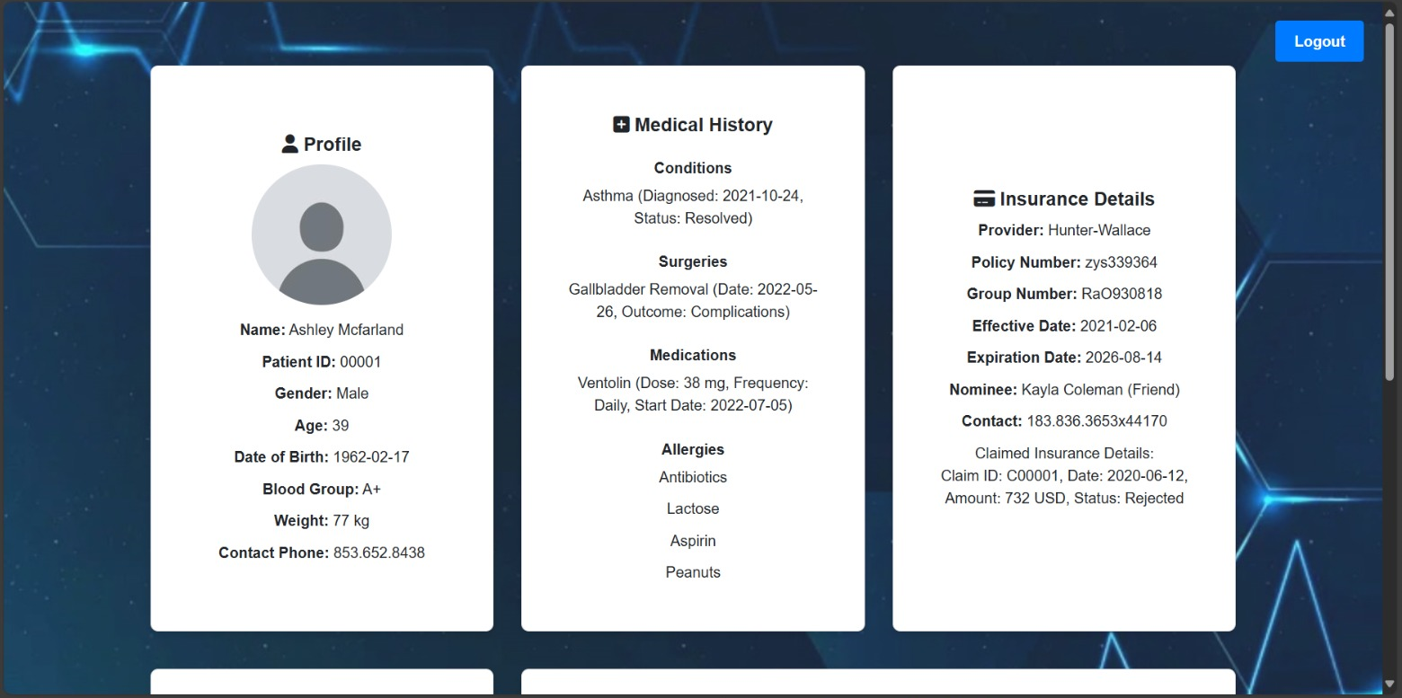
Output – User Interface (Patient)
Patient’s Dashboard

Slide 12
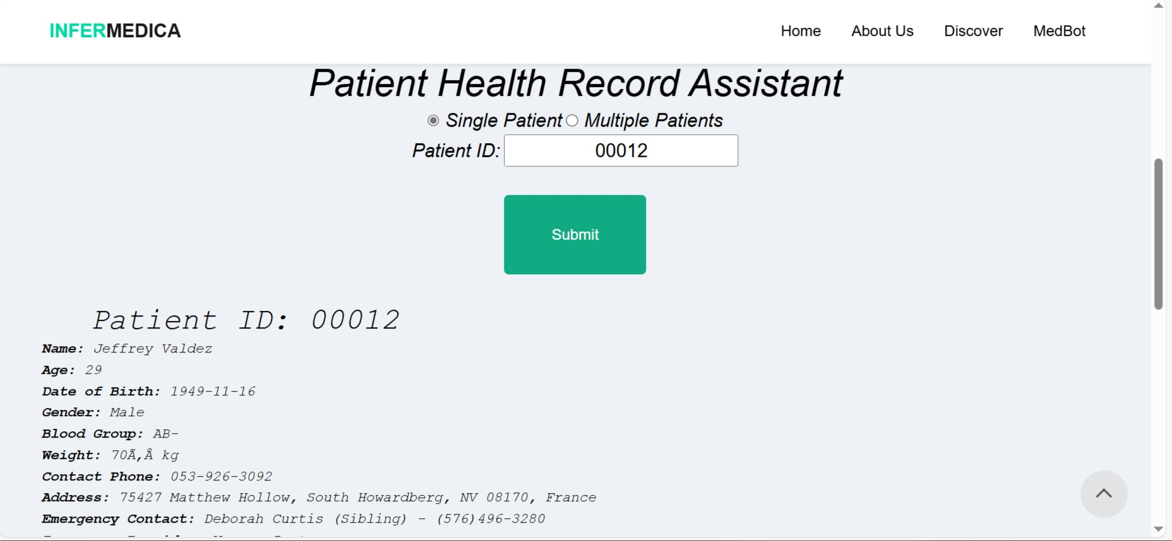
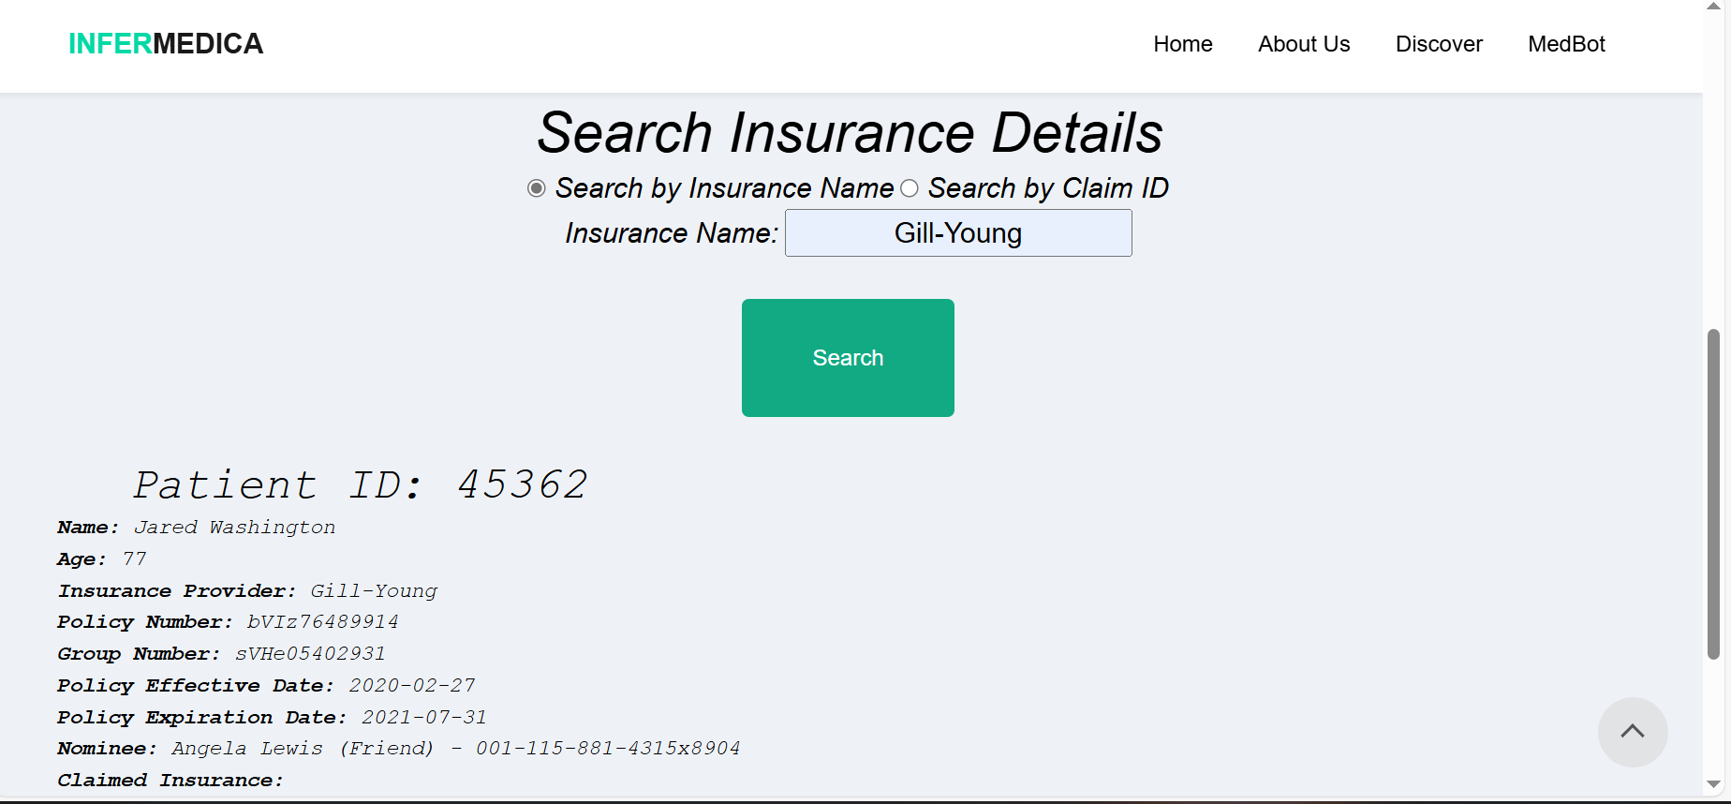
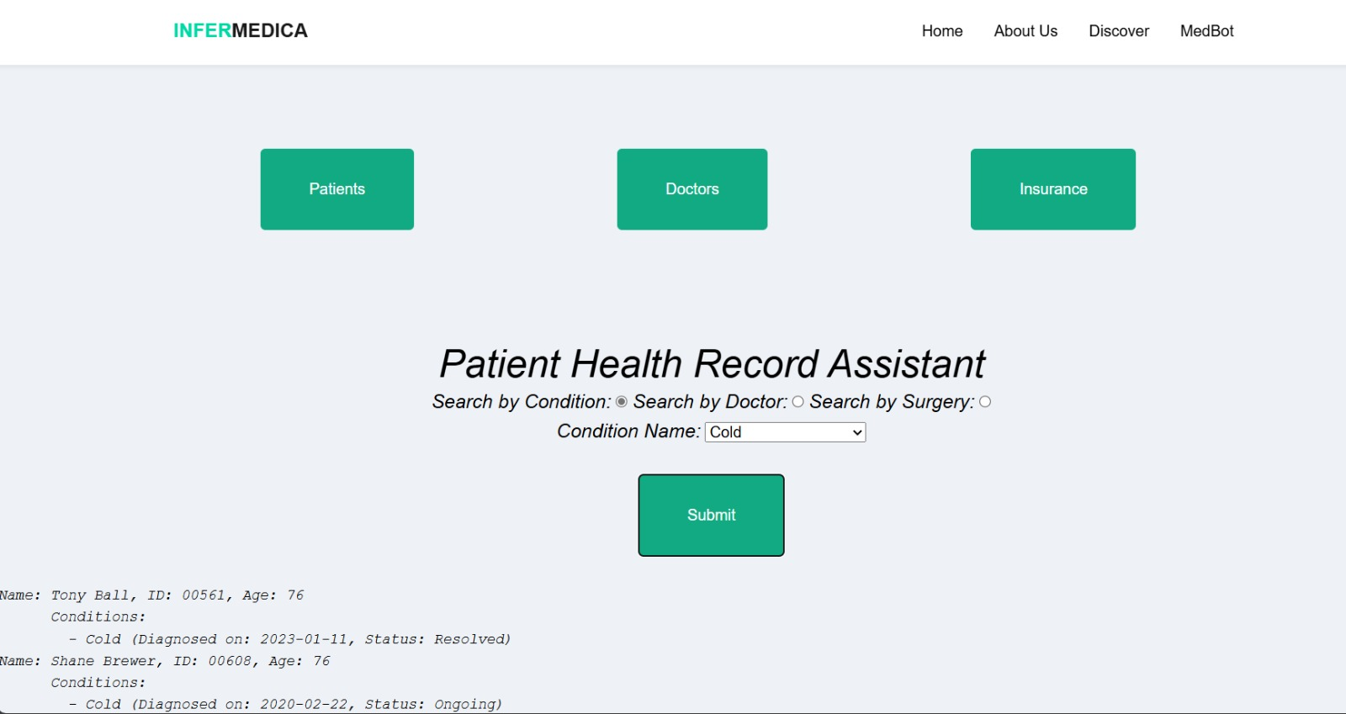
Output – Records Retrieval
Patients
Insurance
Doctors

Slide 13
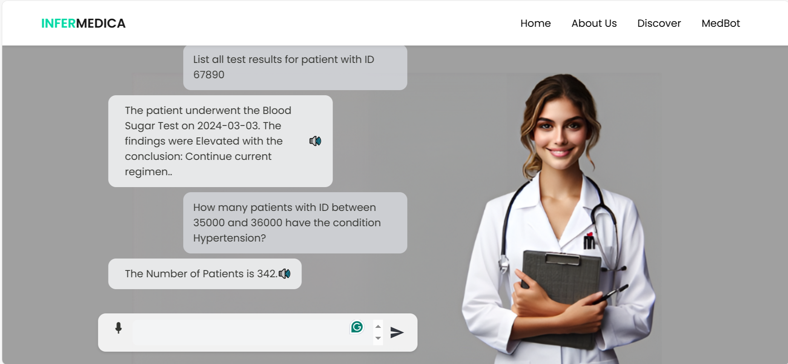
Output-MedBot

Slide 14

Source Code
Turning Complex Medical Information into Straightforward Insights for Enhanced Decision-Making.
GitHub Repository link: https://github.com/PrathiPriya/Infermedica.git
Demo video link:
https://drive.google.com/file/d/19Vcbaonlbc26P7dHzhifw77npldTG2DJ/view?usp=sharing
.

Slide 15
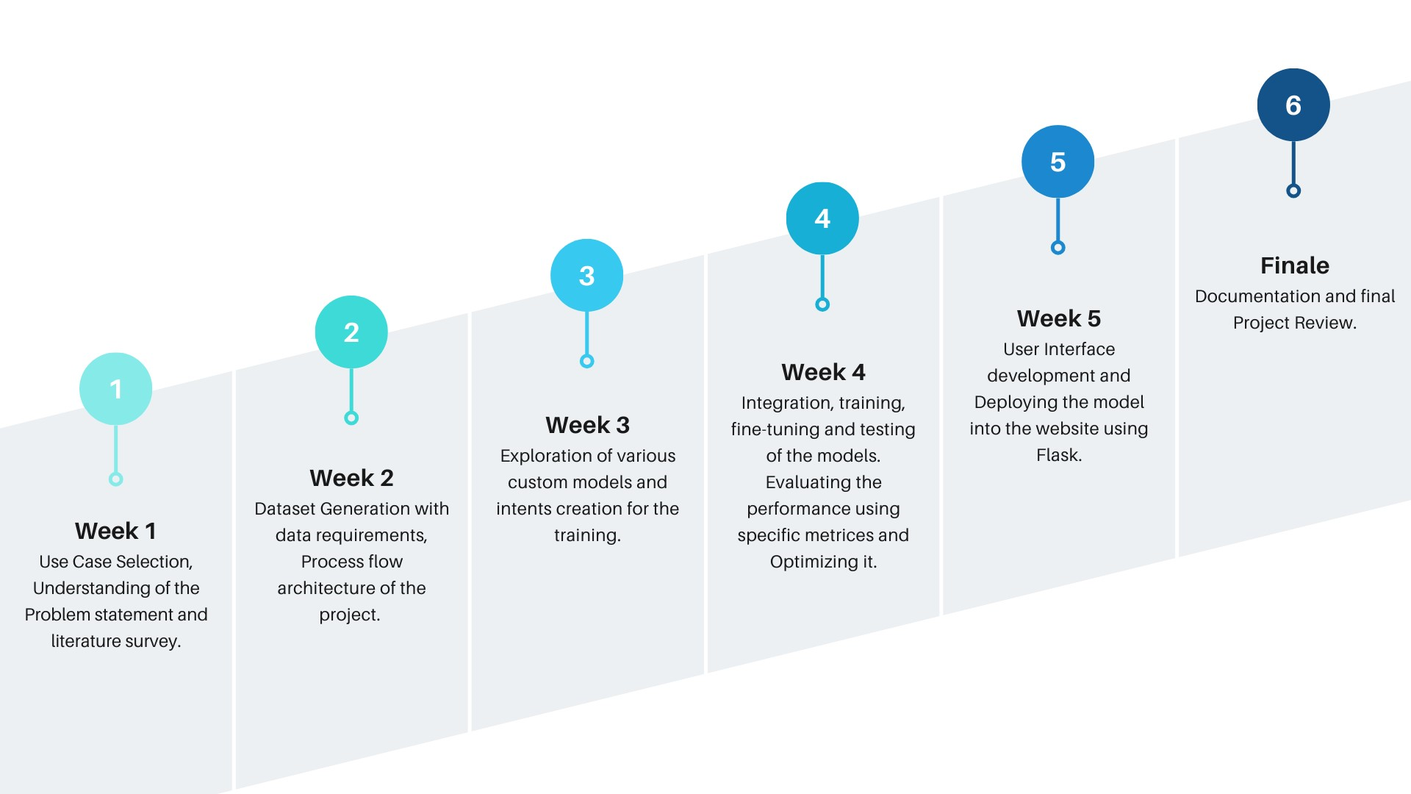
Estimation of development, Roadmap
.

Slide 16
Mentor Connect details
Date of connect | Time | Agenda of the meeting | Suggestions | Mentors
17-07-2024 | 6pm | Problem Statement understanding and Literature survey | Additional research on papers related to each part of the use case | Internal mentors
23-07-2024 | 11am | Dataset, Model confirmation | Matrices for the models and the count of data | Internal mentors
25-07-2024 | 6pm | 1st Review and Project Idea explanation | Availability of real-time data, User interface ideas, and explanation for the choice of custom models | Cognizant mentors and internal mentors
30-07-2024 | 9am | Model Training and Integration | Testing and evaluation of the models | Internal mentors
01-08-2024 | 6pm | Project Progress Review | User interface enhancement, usage of various functions such as aggregates for the BART and fallback mechanism | Cognizant mentors and internal mentors
05-08-2024 | 10am | Enhancement in Fine-tuning of the model | Other retrieval options | Internal mentors
08-08-2024 | 6pm | Project Demo | Security and authentication, conversational Medbot | Cognizant mentors and internal mentors
13-08-2024 | 6pm | Final Project Presentation and Review | GTTS, Hosting of the project | Cognizant mentors and internal mentors
.

Slide 17
THANK
YOU

Slide 18

ADDITIONAL INFORMATION

Slide 19
Literature Survey
Paper 1: Efficiency of JSON for Data Retrieval in Big Data​ (2017- Research Gate )
Methodologies and Algorithms Used:​
Query Execution and Parsing Algorithms: Implements and compares algorithms for executing queries and parsing data in JSON formats.​
T-Test Analysis: Conducts T-test analysis to compare the means of elapsed time for query execution using JSON.​
Results:​
JSON is found to be efficient in terms of storage. This is attributed to JSON's lightweight structure and faster parsing capabilities.​
Disadvantages:​
Dataset Size Limitation: Evaluated up to 50,000 records, which may not represent larger big data scenarios.​
Specific Use Case: Focuses on publication data, limiting generalizability to other data types.​
Limited Performance Metrics: Excludes important metrics like memory usage and network overhead.​
.

Slide 20
Literature Survey
Paper 2: Information Retrieval System for Searching JSON Files with Vector Space Model Method​ (2019-IEEE)
​
Methodologies/Algorithms used:
The paper describes a methodology for processing 140 scientific journals by converting PDFs to JSON using PDFBox, reading JSON files with Google GSON, tokenizing, filtering non-essential words, and stemming using ECS Stemming.
Indexed data is weighted using TF-IDF. The Information Retrieval System uses the Vector Space Model (VSM), applying TF-IDF and cosine similarity to rank documents by relevance, ensuring efficient information retrieval.
Evaluation metrics: TF-IDF and cosine similarity for accurate document-query matching.
Results:
85% success rate in converting PDFs to JSON, The indexing process stores 987 unique terms and can perform searches within 180-200 milliseconds.
Disadvantages:
Stemming Issues: The process sometimes produces incomprehensible results for English words and has language limitations
Memory Dependence: Slows down as the number of indexed documents increases.
.

Slide 21
Literature Survey
Paper 3: BioBERT: A Pre-trained Biomedical Language Representation Model for Biomedical
text mining (2019-Oxford)​
​
​Methodologies/Algorithms used:
Models like LSTM and CRF have improved tasks like Biomedical Relation Extraction (RE) and Named Entity Recognition (NER)Biomedical Relation Extractions are improved using deep learning models like BERT. ​
BioBERT, pre-trained on large biomedical corpora (like PubMed), outperforms general models by a notable margin and uses WordPiece Tokenization.
Results:
Shows a 0.62% improvement in F1 score compared to previous models
2.80% improvement in F1 score over state-of-the-art models.
Achieves improvements such as a 12.24% MRR improvement over previous models.
Disadvantages:
Requires significant computational resources for training and fine-tuning, limiting its accessibility to smaller research groups.
.

Slide 22
Literature Survey
Paper 4: IntelliDoctor – AI-based Medical Assistant ​(2019-IEEE) ​
Methodologies /Algorithms Used:​
The system had been trained using real-world cases with several thousands of clinical records, through information extraction using Natural Language Processing. ​
The system is powered by a sophisticated artificial intelligence engine based on the Naïve Bayes classifier.​
Results:​
It takes the symptoms from users and understands it into a medical condition. It then generates a set of questionnaires and asks the user through interaction and this predicts the closest medical condition.​
​
Disadvantages:​
Handling sensitive health data always raises privacy and security issues.​
The effectiveness of the app relies heavily on user engagement and compliance
.

Slide 23
Literature Survey
Paper 5: Med-BERT Pre-trained contextualized embeddings on large-scale structured electronic health
record for disease prediction​​
​
Methodologies /Algorithms Used:​
Masked LM​: This task involves predicting a masked code using sequential information from both forward and backward directions.​
Prolonged LOS: Prolonged Length of Stay refers to the extended duration that a patient remains in a healthcare facility, such as a hospital, beyond the typical or expected time for their particular condition or treatment.​ ​
It uses Deep Learning Models (RETAIN, GRU, and Bi-GRU) and Code Embeddings (BEHRT and G-BERT)​.
Result:​
Med-BERT significantly improves prediction accuracy in EHR tasks, enhancing AUC values of models by up to 7% and demonstrating effective transfer learning across datasets.​​
Disadvantages:​
Med-BERT shows less improvement on complex models like RETAIN, and smaller training sizes result in less stable outcomes
.

Slide 24
Literature Survey
Paper 6: Evaluation of NoSQL database with respect to JSON format (2022)​
​
Methodologies/Algorithms used: ​
Document-oriented approach: MongoDB stores data in documents that are similar to JSON format. This approach is beneficial for handling unstructured data and offers flexibility in data modeling.​
The algorithm involves the evaluation of MongoDB's indexing and replication mechanisms to enhance query performance and ensure high availability and disaster recovery.​
Results:​
MongoDB supports real-time analytics and flexible schema, making it ideal for enterprise applications​
Disadvantages:​
Needs careful planning to increase efficiency. ​
MongoDB can be hard to use for applications that need strict data consistency and integrity.
.

Slide 25
Literature Survey
Paper 7: Database Management for Health Records and Efficient Querying of JSON Data in MongoDB by Chodorow ​(2013- Research Gate )
​
Methodologies/Algorithms used:​
NoSQL Database Utilization: MongoDB, a NoSQL database, is employed for managing health records, offering flexibility with its schema-less design and ability to handle diverse data structures inherent in healthcare data.​
Indexing Strategies: Implements various indexing techniques, including compound and text indexes, to optimize query performance and ensure efficient access to frequently queried data.​
​
Results:​
Improved data retrieval times for complex queries compared to relational databases.​
Greater flexibility in managing evolving health record schemas.​
​
Disadvantages:​
Requires careful design to optimize performance.​
MongoDB's default approach can be challenging for applications that need strong data consistency and integrity.​
.

